Slide 1
Chapter 12: I/O, 8255 and Device Interfacing
CSE 3442
Tom Rethard

Slide 2
I/O Instructions in the 8086
8086/88 access I/O from ports only
Two instructions
  IN
  OUT
8 bit data ports: two formats
  Format 1: for ports 0-255
  Format 2: for ports 0-65536
1b bit ports: two formats
  Similar to 8 bit usage

Slide 3
8-bit Format 1 I/O
IN AL,port#
  Moves data from AL to the port
OUT port#,AL
  Moves data from the port to AL
Ports 0-255
Port number on A0-A7
Holdover from 8080/8085

Slide 4
8-bit Format 2 I/O
MOV DX,port#
IN AL,DX
  Copies data from AL to the port identified in DX
MOV DX,port#
OUT DX,AL
  Copies data from the port identified in DX to AL
Ports 0-65,536
Port number on A0-A15
Also allow rapid change of port#, as when parameterized by caller

Slide 5
16-bit Format 1 I/O
IN AX,port#
  Moves data from AL to the port
OUT port#,AX
  Moves data from the port to AX
Ports 0-255 on A0-A7
Holdover from 8080/8085

Slide 6
16-bit Format 2 I/O
MOV DX,port#
IN AX,DX
  Copies data from AL to the port identified in DX
MOV DX,port#
OUT DX,AX
  Copies data from the port identified in DX to AX
Ports 0-65,536 on A0-A15
Also allow rapid change of port#, as when parameterized by caller

Slide 7
16-bit I/O
But I/O ports are all 8-bit, so …
  OUT 47H,AX
sends data to ports 47H and 48H
AL is sent to port 47H
AH is sent to port 48H

Slide 8
Bus Timing
Similar to memory timing, but…
  Uses IOR and IOW instead of MEMR and MEMW
  Port address on A0-A7 or A0-A15
  No segment register is used – port# is always immediate or in register

Slide 9
Example
AX=76A9H
Program
MOV DX,648H
OUT DX,AX

Slide 10
Example - 8088
I/O Cycle 1
  T1 Address 0648H put on AD0-AD7, A8-A15 latched in when ALE activated
  T2 Low byte of data (A9H) on AD0-AD7 when IOW activated
  T3 Setup time
  T4 Byte written to port, assuming no wait states

Slide 11
Example - 8088
I/O Cycle 2
  T1 Address 0649H on AD0-AD7, A8-A15 latched in when ALE activated
  T2 High byte of data (76H) on AD0-AD7 when IOW activated
  T3 Setup time
  T4 Byte written to port, assuming no wait states

Slide 12
Example - 8086
I/O Cycle 1 (and only 1!)
  T1 Address 0648H on AD0-A15; BHE=low latched by 74LS373 when ALE activated
  T2 76A9H placed on AD0-AD15 (A9H on AD0-AD7, 76H on AD8-AD15)
  T3 setup time
  T4 A0=0 and BHE are used to sort out the bytes

Slide 13
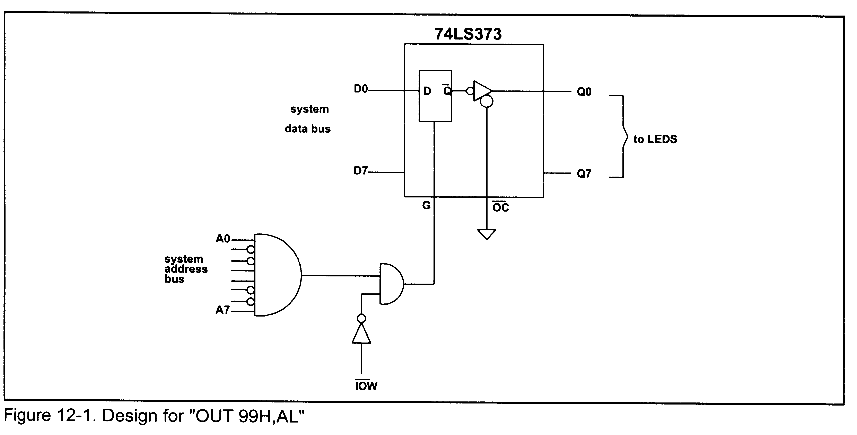
I/O Design – OUT 99H,AL
Notes:
!OC must be grounded
High-to-low pulse to latch the data onto the data bus
Common to AND the output of the address decoder with the control signal IOR or IOW to prividate the latch or tri-buffer activator

Slide 14
I/O Design – OUT 99H,AL
T1 address 99H provided to A0-A7 via AD0-AD7 and ALE
T2 IOW provided, contents of Al released in to AD0-AD7
T3 setup time
T4 Contents of AL (2F) latched into the 74LS373, with IOW going from low to high

Slide 15
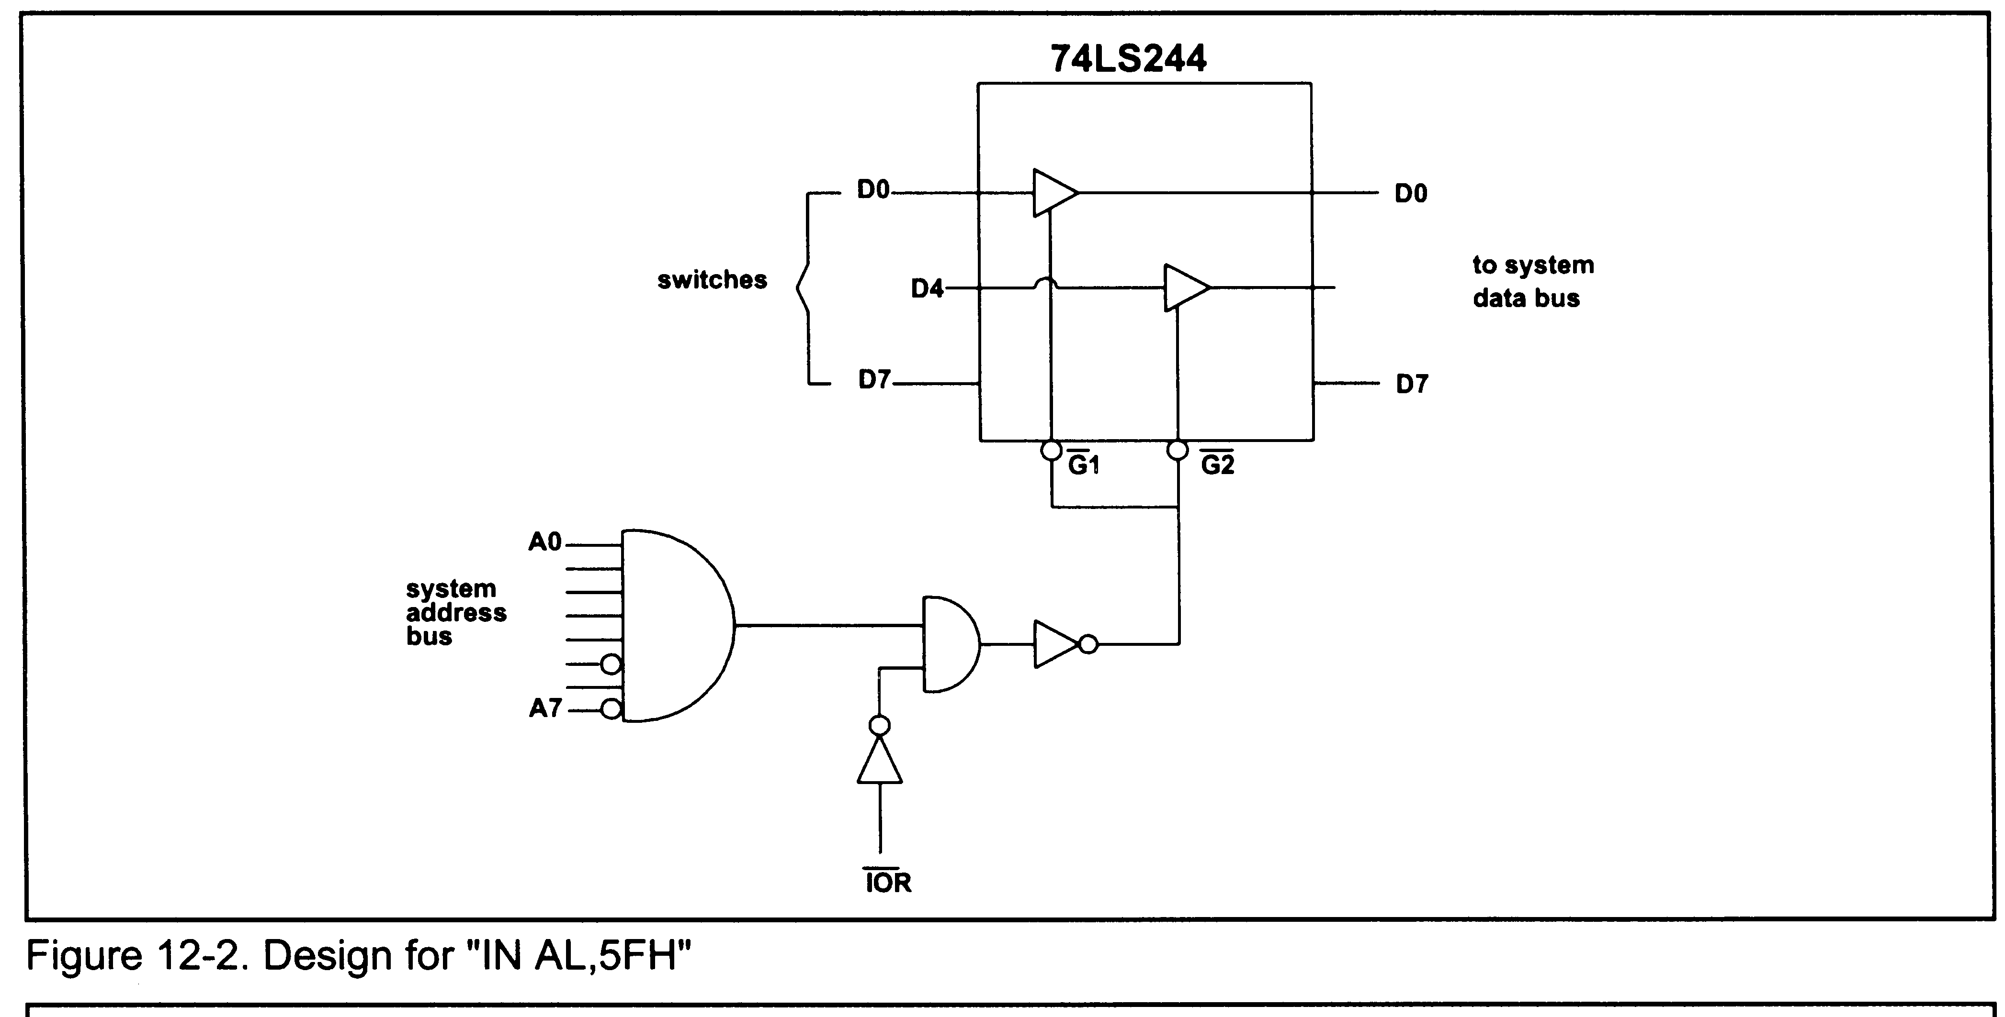
I/O Design – IN AL,5FH
Notes:
Note that !G1 and !G2 must both be true, because each only controls 4 bits of the data

Slide 16
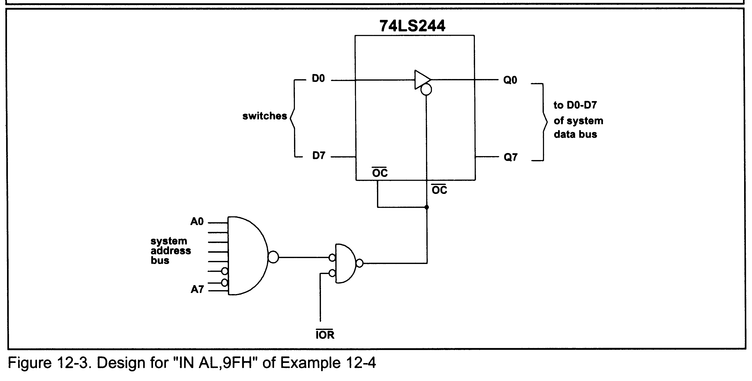
I/O Design – IN AL,9H (tristate buffer)
Notes:
9FH is decoded, then ANDed with IOR.
To activate !OC of the 74LS244, it must be inverted to match !OC
The use of the tri-state buffer allows data that is on the buss only for a short period to be latched and held for later use.

Slide 17
Memory-Mapped I/O
8086/88 use peripheral I/O
  Also called isolated I/O
  Used ports
Other processors – Motorola 6800 family, most RISC processors – use memory-mapped I/O

Slide 18
Memory-Mapped I/O
I/O ports are located with a memory address
Uses normal instructions to access I/O ports, such as MOV
Entire address must be decoded to access I/O port
Uses MEMR and MEMW instead of IOR and IOW
Peripheral I/O limited to 64K ports; memory-mapped limited to size of addressable memory
MMIO can operate on data without moving it to memory
Can cause address space fragmentation

Slide 19
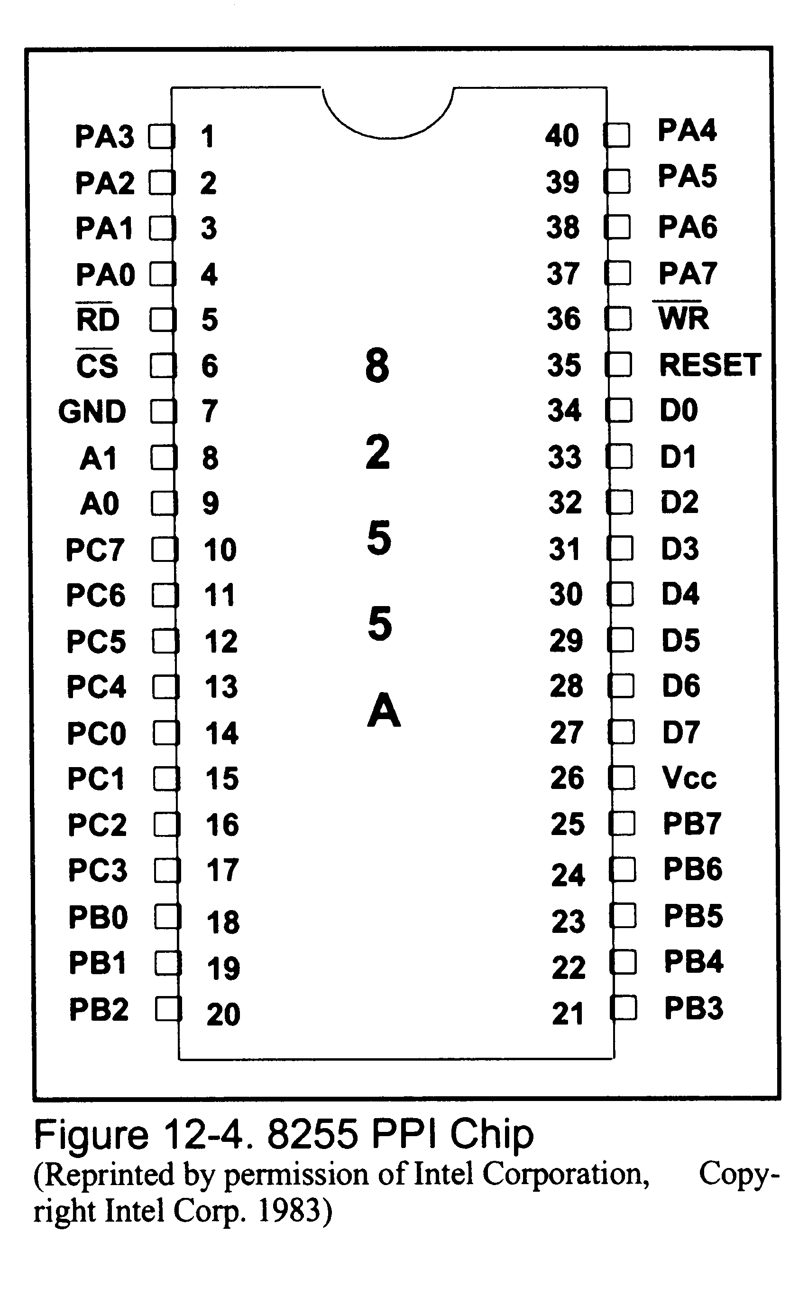
8255 Chip
PA0-PA7: Port A
PB0-PB7: Port B
PC0-PC7: Port C
RD and WR: read/write
RESET: reset (obviously)
A0, A1 and CS: port selection

Slide 20
8255 Chip – Port Selection
A0, A1 and CS
CS | A1 | A0 | Selects
0 | 0 | 0 | Port A
0 | 0 | 1 | Port B
0 | 1 | 0 | Port C
0 | 1 | 1 | Control Register
1 | 0 | 0 | Not selected

Slide 21
Mode Selection
Control register sets operation mode of each port
4 different modes
  Mode 0 – simple input or output
  Mode 1 – I/O with handshaking
  Mode 2 – bi-directional I/O with handshaking
  BSR – bit set/reset
Mode set by sending a byte to the control register

Slide 22
Mode 0 – Simple I/O Mode
Any port (A, B, CL, CU) can be programmed as input or output
No control of individual bits

Slide 23
Mode 1 – I/O w/ Handshaking
Ports A and B can be used as input or output
Port C is used for handshaking signals

Slide 24
Mode 2 – I-directional I/O w/ Handshaking
Ports A can be used as bi-directional port
Port C is used for handshaking signals
Port B can be used as simple I/O or handshake Mode 1

Slide 25
BSR Mode
Only port C
Only individual bits

Slide 26
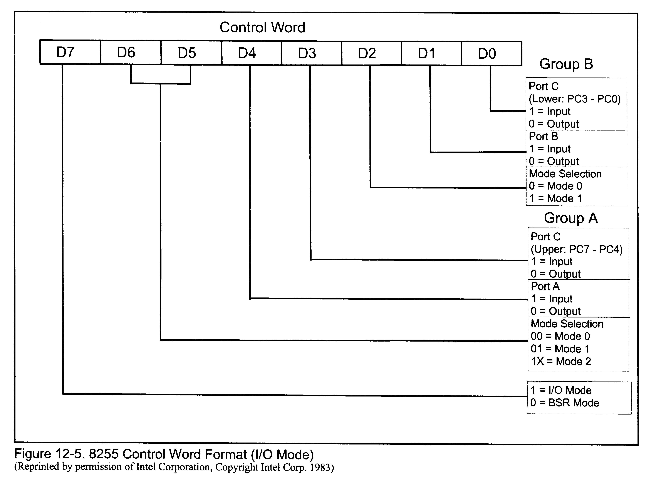
8255 Control Word Format

Slide 27
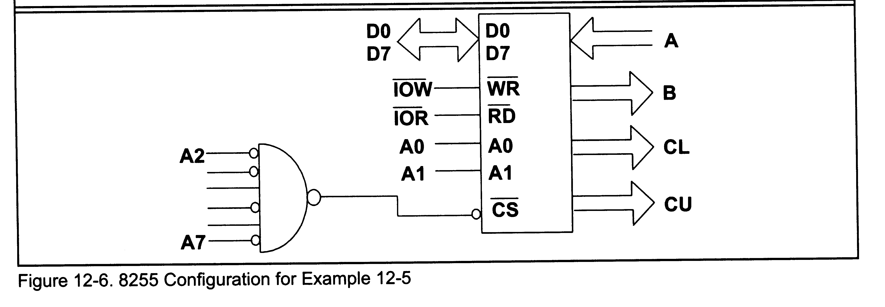
Example 12-5

Slide 28
Example 12-5
Configuration:
  Port A: input
  Port B: output
  Port C: output (all bits)
Problem: Find
  Port addresses of A, B, C and the control register
  Control byte value for this config
  Program the ports to input data from Port A and send it to both Ports A and C

Slide 29
Example 12-5/Port Addresses
CS | A1 | A0 | Address | Port
0101 00 | 0 | 0 | 50H | Port A
0101 00 | 0 | 1 | 51H | Port B
0101 00 | 1 | 0 | 52H | Port C
0101 00 | 1 | 1 | 53H | Control Register

Slide 30
Example 12-5/Control Word
90H or 1001 0000B

Slide 31
8255 Control Word Format
1 0 0 1 0 0 0 0

Slide 32
Example 12-5/Code
MOV AL,90H ;control byte
OUT 53H,AL ;write cb
IN AL,50H ;read byte on PA
OUT 51H,AL ;write byte to PB
OUT 52H,AL ;write byte to PC

Slide 33
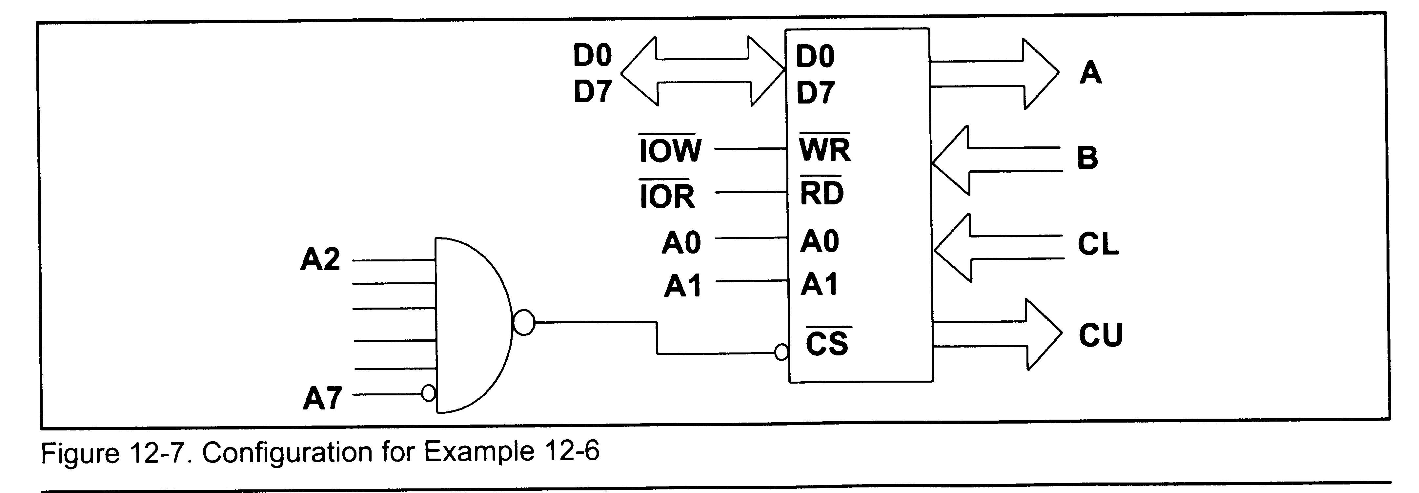
Example 12-6

Slide 34
Example 12-6
Configuration:
  Port A: output
  Port B: input
  Port CL: input
  Port CU: output
Problem: Find
  Port addresses of A, B, C and the control register
  Control byte value for this config
  Program the ports to copy data from Port B to Port A; also copy PCL to PCU

Slide 35
Example 12-5/Port Addresses
CS | A1 | A0 | Address | Port
0111 11 | 0 | 0 | 7CH | Port A
0111 11 | 0 | 1 | 7DH | Port B
0111 11 | 1 | 0 | 7EH | Port C
0111 11 | 1 | 1 | 7FH | Control Register

Slide 36
Example 12-5/Control Word
83H or 1000 0011B

Slide 37
8255 Control Word Format
1 0 0 0 0 0 1 1

Slide 38
Example 12-5/Code
MOV AL,73 ;control byte
OUT 7FH,AL ;write cb
IN AL,7DH ;read PB
OUT 7CH,AL ;write PA
IN AL,7EH ;read PCL
AND AL,0FH ;mask upper bits
ROL AL,1 ;shift up
ROL AL,1
ROL AL,1
ROL AL,1
OUT 7EH,AL ;write PCU

Slide 39
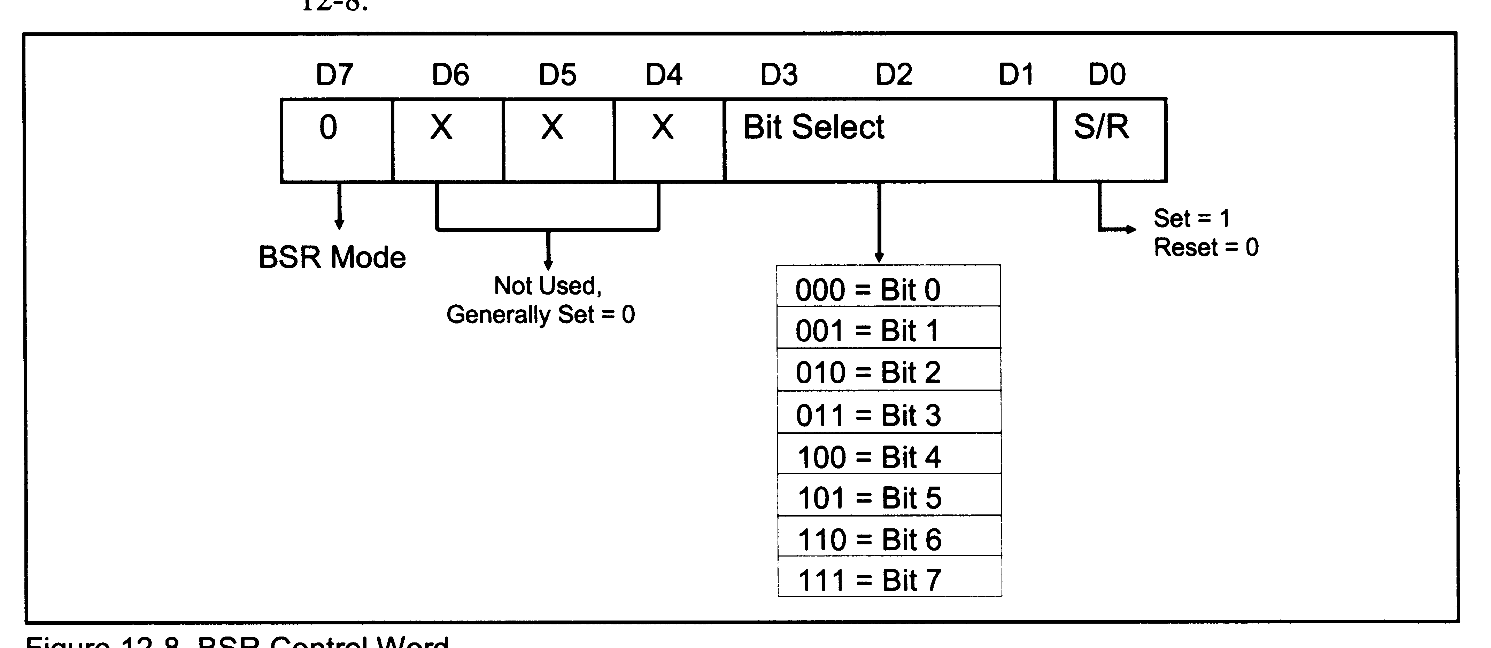
BSR Mode Control Word

Slide 40
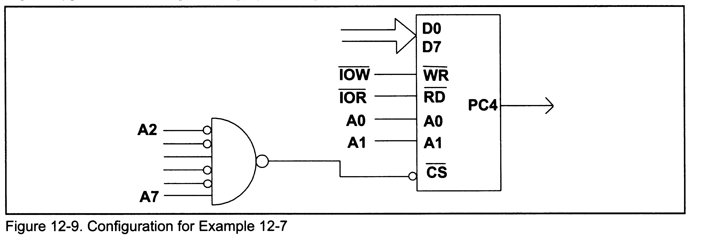
Example 12-7

Slide 41
Example 12-7
Program PC4 to generate a pulse of 50ms with 50% duty cycle
Bit D7 must be low.
For PC4 to be high, need control word of “0xxx1001”.
For PC4 to be low, need control word of “0xxx1000”

Slide 42
Example 12-7
MOV AL,00001001B ;load cb
OUT 93H,AL ;set PC4 high
CALL DELAY ;time high pulse
MOV AL,00001000B ;load cb
OUT 93H,AL ;set PC4 low
CALL DELAY ;time low pulse

Slide 43
Example 12-7

Slide 44
Example 12-8
Set PC2 to high
Use PC6 to generate a square wave 66% duty cycle continuously

Slide 45
Example 12-8a
MOV AL,0xxx0101B ;load cb
OUT 93H,AL ;set PC2 high

Slide 46
Example 12-8b
AGAIN MOV AL,0xxx0101B ;load cb
OUT 93H,AL ;set PC2 high
CALL DELAY ;delay 1/3
CALL DELAY ;delay 1/3
MOV AL,0xxx0100B ;load cb
OUT 93H,AL ;set PC2 low
CALL DELAY ;delay 1/3
JMP AGAIN ;loop

